Slide 1
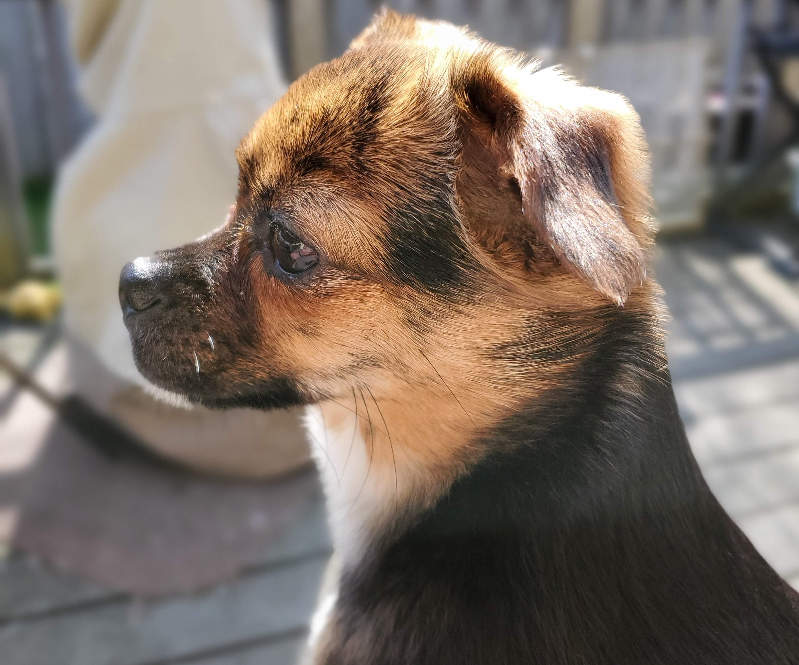

Web APIs & NLP
presents
Brandie Hatch

Slide 2

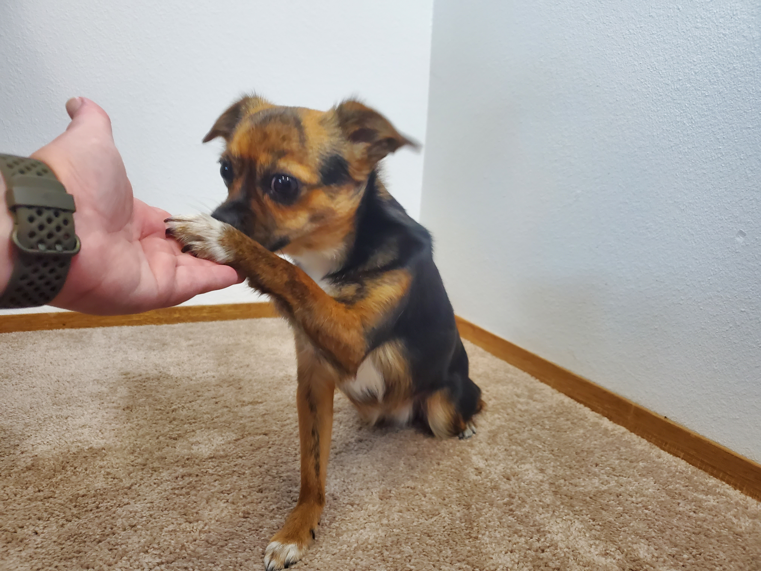
chewie
Video of Chewie learning to high five
Ten-pound rescue pup who loves everyone and plans to be a therapy dog once the AKC Canine Good Citizen test is passed.
Learning how to High Five
Notes:
Grab the audience’s attention

Slide 3
Problem & Goals
Build a classification model that can be used to identify Service Dogs vs Dog Training
Service dogs require a lot of training.
What are the classification opportunities between the subreddits for Service Dogs and Dog Training?
How can those classifications help to predict training opportunities for service and other dogs?
Notes:
Introduce problem statement

Slide 4
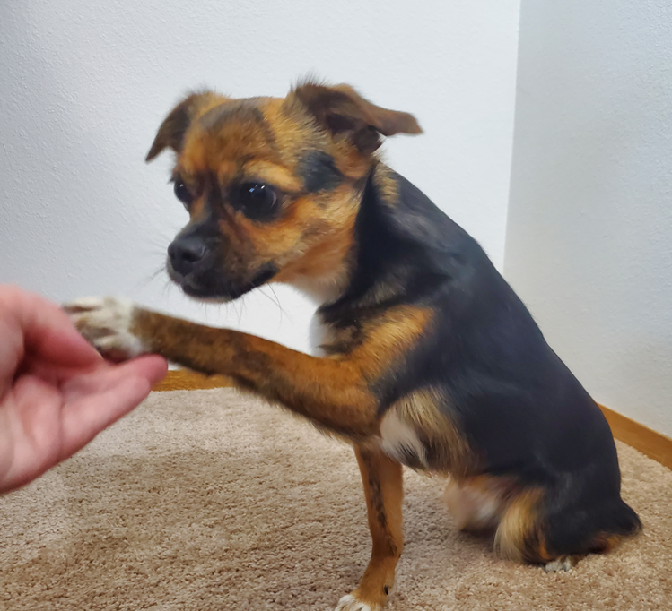
Background
Attempts at this particular study have not been made in the past.
By the end of the presentation today, the goal is to communicate:
investigative process
inferences
recommendations
Notes:
Key takeaway: Research gathered and how this may dictate our own modeling.
Communicate what the goal is if someone has already tackled this problem before and how we decided to approach in making a model better (e.g. feature selection, what are we doing differently from other people before?)
Inference - we want, by the end of the presentation, to communicate strengths of relationships and effect on y variable (classification of plant)
Attempts at this study have been made
We’re adapting the previous study approaches for inference

Slide 5
Data Collection
Data Pulled from Subreddit:
The Dog Training Subreddit data set included 4730 observations of nine variables.
The Service Dogs Subreddit data set included 4717 observations of nine variables.
Variable | Notes
Subreddit | Classification tool
Title | Text to be vectorized and used in model
Self text | Text to be vectorized and used in model
Number of Comments | Used as numerical tool in model
Score | Used as numerical tool in model
Over_18 | Helped to remove inappropriate content (removed)
Author | Collected in case of concerns (removed)
Created UTC | Utilized for collecting most recent data (removed)
Notes:
Key takeaway: Research gathered and how this may dictate our own modeling.
Communicate what the goal is if someone has already tackled this problem before and how we decided to approach in making a model better (e.g. feature selection, what are we doing differently from other people before?)
Inference - we want, by the end of the presentation, to communicate strengths of relationships and effect on y variable (classification of plant)
Attempts at this study have been made
We’re adapting the previous study approaches for inference

Slide 6
EDA/Cleaning
During cleaning, no nulls that needed to be removed
There was not much difference between the scores of the two subreddits:
Service Dogs mean score was 1.5
Dog Training mean score was 1.0
There was a significant difference in the number of comments for each subreddit:
Service Dogs number of comments mean was 9.2
Dog Training number of comments mean was .8
*Number of comments will provide a good numerical predictor in the model
Class imbalance was almost non-existant:
Combined Title and Self text into a single column for Vectorization, Lemmatizing, Stemming, and Tokenizing
Service Dogs | 0.499576
Dog Training | 0.500424

Slide 7
Data Exploration: Most common words
Title
Dog
Service
Training
Help
Selftext
Dog
Not
Out
Dogs
Notes:
showed common words for both Title and Selftext. Removed hand created list of stopwords because the original set of 15 common words were primarily stop words and I did not get a good conclusion from just using Stopwords “English”
'do', 'about', 'just', 'has', 'are', 'would', 'any', 'will', 'have', 'had', 'his', 'hers', 'theirs', 'them', 'been', 'a', 'an', 'your', 'as', 'at', 'when', 'where', 'why', 'what', 'her', 'him', 'can', 'get', 'we', 'or', 'so', 'if', 'was', 'me', 'this', 'be', 'the', 'you', 'me', 'to', 'and', 'in', 'on', 'is', 'for', 'how', 'with', 'my', 'he', 'she', 'they', 'it', 'of', 'but', 'that'

Slide 8
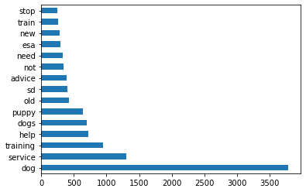
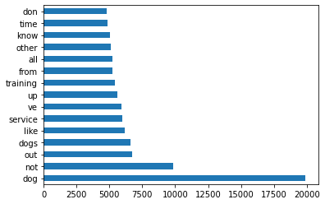
Data Exploration: Most common words
Title
Dog
Service
Training
Help
Selftext
Dog
Not
Out
Dogs
Notes:
viewed the top ten entries for the word 'don', but I think it is pulling into the most frequently used because of the contraction "don't"

Slide 9
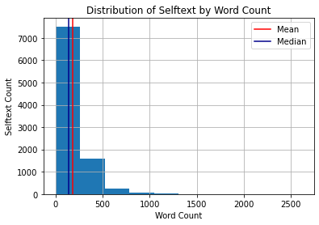
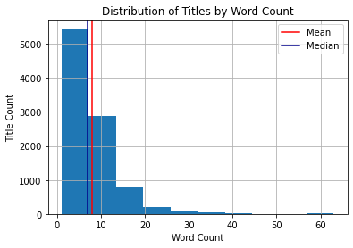
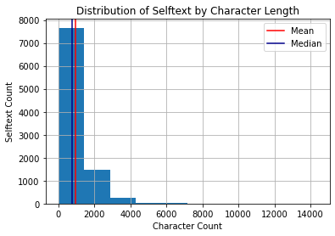
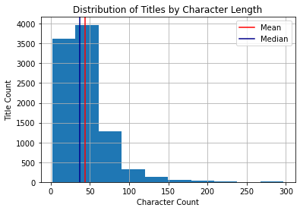
Data Exploration: Longest & Shortest
Notes:
Considering the data that was shown from the longest and shortest word counts, I will want to remove characters before modeling.
Reviewed to determine if it is worth more review by looking at the five longest and five shortest Titles and Selftext description word counts.

Slide 10
Investigative Process
Models | Best Scores
Random Forest Classifier | 0.9554882664647995
Decision Tree Classifier | 0.953217259651779
Logistic Regression | 0.9654806964420892
SVM: Linear SVC | 0.9609386828160484
SVM: C-Support Vector Classification | 0.8996214988644965
Column Transformer
Count Vectorizer
Standard Scaler
Pipeline
Column Transfer
Classification Models
Grid Search CV
Parameters
Fit, Best Score, & Best params
Notes:
To build a classification model that can be used to identify Service Dogs vs Dog Training
After combining both subreddits, doing Exploratory Data Analysis, and cleaning the data…
Defined X and Y to do Train, Test, Split
From there I utilized a column transformer, pipeline, and gridsearch to transform text to vectors, fit and transform models, and then run the models with parameters to get best score/params

Slide 11
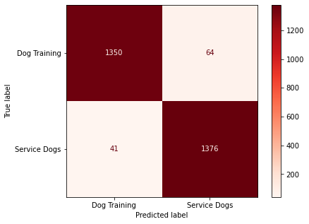
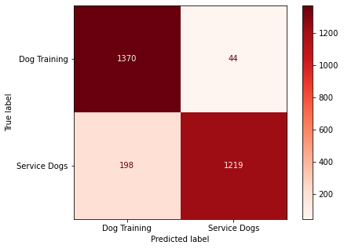


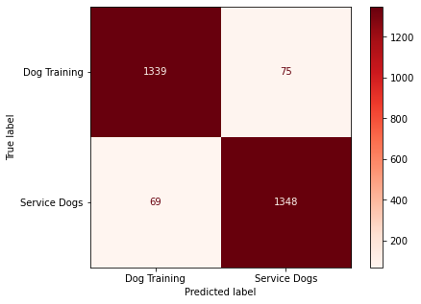
Confusion matrix displays
SVM: Linear SVC
SVM: C-Support Vector Classification
Logistic Regression
Random Forest Classifier
Decision Tree Classifier

Slide 12
Model Findings
Overall, the Logistic Regression model was the best model to identify Service Dogs vs Dog Training Subreddits.
The SVM: C-Support Vector Classification model could also be used.
Metric | Best Model
Bias/Variance Tradeoff | Logistic Regression, SVM: C-Support Vector Classification
Accuracy | Logistic Regression
Precision | SVM: C-Support Vector Classification
Recall | Logistic Regression
Specificity | SVM: C-Support Vector Classification
F1 Score | Logistic Regression
Notes:
__Bias/Variance Tradeoff__ All of the models were overfit where the train score was higher than the test score. The *Logistic Regression* model was the least overfit and performed the best in the tradeoff because it had the highest train/test scores. The *SVM: C-Support Vector Classification* was a close second because the difference between the train and test scores was the lowest. <br>
__Accuracy__ Number of correct predictions divided by the total number of predications, multiplied by 100 to get percentage: *Logistic Regression* had the best accuracy because it predicted the correct Subreddit 96.7% of the time. This is a reliable indicator because of the basically even class distribution.<br>
__Precision__ Number of true positives divided by the number of true positives plus the false positives: *SVM: C-Support Vector Classification* had the best precision with 96.1% precisely predicted the correct Subreddit. This is not the best indicator because of the even class distribution. Precision in this situation is showing us how many submissions that were predicted as being correct and actually were correct.<br>
__Recall__ Fraction of samples from a class which are correctly predicted by the model: *Logistic Regression* had the best recall because of the correctly labeled Subreddits, the model predicted 97.8% correct. <br>
__Specificity__ Fraction of samples from a class which are incorrectly predicted as incorrect (True negative rate): *SVM: C-Support Vector Classification* had the best recall because of the incorrectly labeled Subreddits, the model predicted those correctly incorrect at 96.8%. This is not a reliable indicator in this specific situation. <br>
__F1 Score__ Combination of precision and recall to check on the balance of the two: *Logistic Regression* has the highest F1 Score, so therefore, is the most balanced of the models

Slide 13
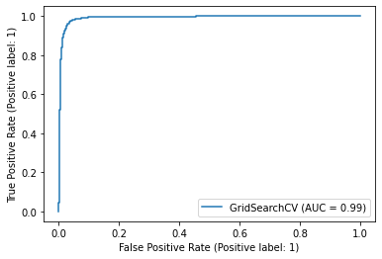

Roc curves
Logistic Regression
SVM: C-Support Vector Classification

Slide 14
recommendations
Problem Statements:
Implications and Next Steps:
What are the classification opportunities between the subreddits for Service Dogs and Dog Training?
How can those classifications help to predict training opportunities for service and other dogs?
Logistic Regression model was most accurate
Did not help predict training opportunities for service or other dogs
Classification opportunities could be to look more into the most common words and compare the differences between each Subreddit
Next steps would include specifically looking for training theories and pedagogy related words

Slide 15
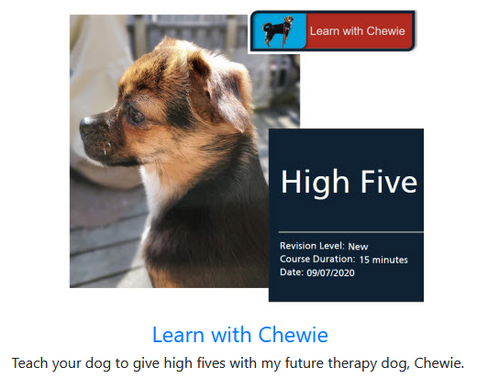
Questions
Follow Chewie’s Adventures:
https://www.instagram.com/chewie_honeybadger/
Connect with Brandie:
/in/brandiehatch • Github/brandiehatch
Notes:
Image of authors
Emails
LinkedIn URLs

Slide 16
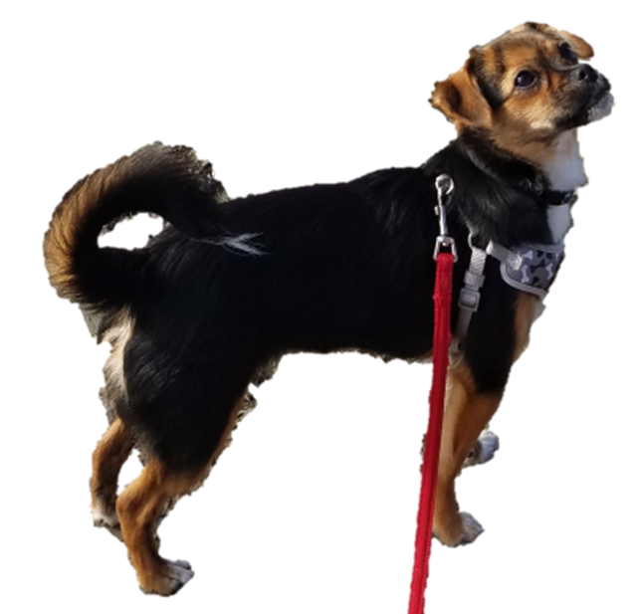

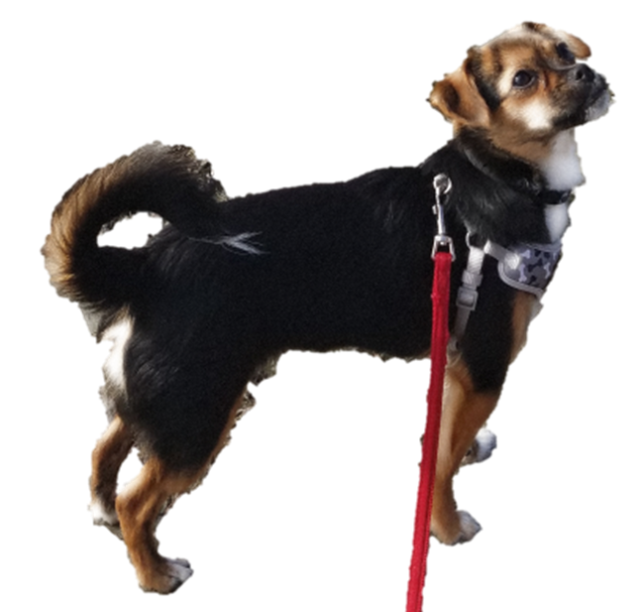
Sources
https://towardsdatascience.com/20-popular-machine-learning-metrics-part-1-classification-regression-evaluation-metrics-1ca3e282a2ce
https://www.tablesgenerator.com/markdown_tables#
API Pushshift
https://www.reddit.com/r/service_dogs/
https://www.reddit.com/r/Dogtraining/

Slide 17
Index

Slide 18
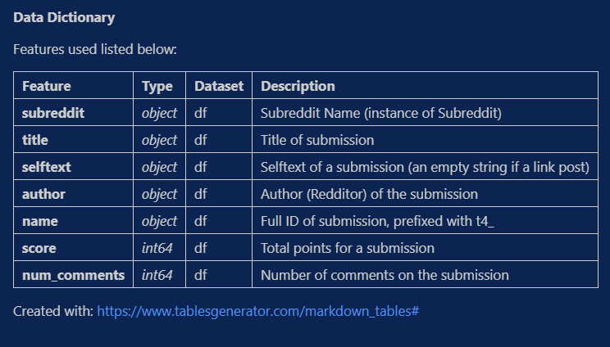
Data dictionary

Slide 19
